Slide 1
Mini Project
SEMESTER - I
“WEATHER APP”
PLAN ACCORDINGLY
Python for Computational Problem Solving (PCPS)
Subject Code: UE23CS151A

Slide 2
Under the guidance of,
Ruby Dinakar J
Asst. Prof
Dept. of CSE
PES University

Slide 3
TEAM MEMBERS
Overview
SRN
NANDAN D
PES2UG23CS363
PES2UG23EC169
PES2UG23AM060
PES2UG23AM066
TARUN ALUR GOWRISHANKAR
MOHAMMED NEHAZ KHAN
NEIL P ADONI

Slide 4
LIST OF IN-BUILD MODULES
Tkinter–for GUI
timezonefinder-find the time zone for any coordinate.
Requests-allows to send HTTP request in py.useful to interact with web API.
PIL-adds support for adding,manipulating & saving image file format.

Slide 5
LIST OF IN-BUILD MODULES
Speech_recognition-to convert the spoken words into text,give a reply.
Pyttsx3-text-to-speech conversion library.
Colorama-to display coloured output in console.
Time-ways of representing time in code,such as object,numbers,and string.

Slide 6
FUNCTIONALITY | MEMBER
GUI AND API INFO RETRIVE | TARUN
SPEECH RECOGNITION AND TEXT TO SPEECH | NANDAN
REPEAT BOX & WELCOME PAGE | NEIL
COLOUR BOX,FILE,ABOUT,HELP | NEHAZ
AQI | TARUN AND NANDAN

Slide 7
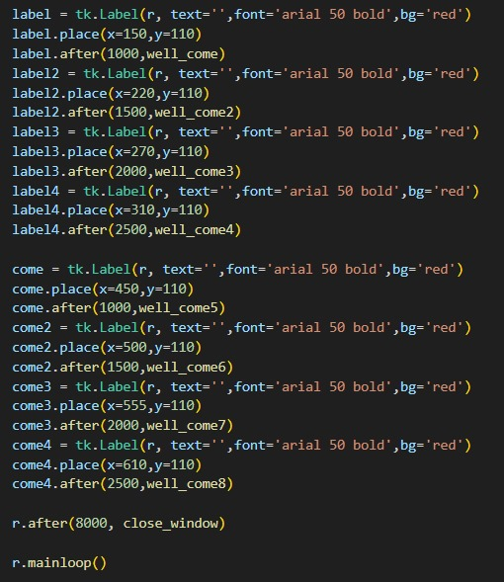
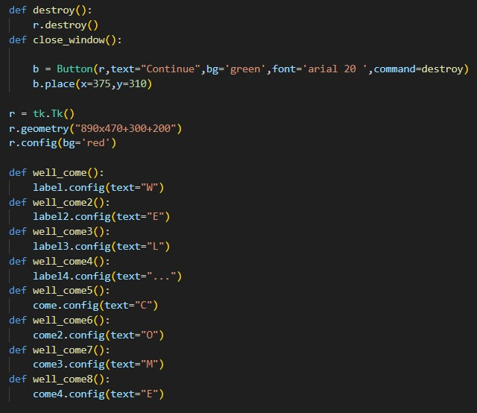
RESULT AND OUTPUT (welcome page)

Slide 8
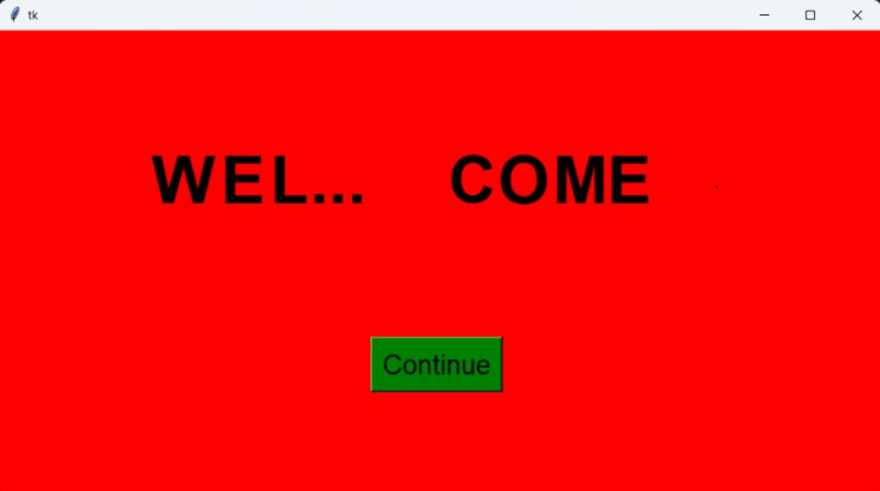

Slide 9
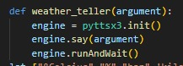
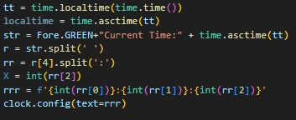
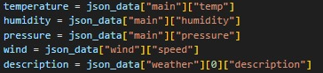
TEXT TO SPEECH
CURRENT TIME DISPLAYER
CURRENT WEATHER DATA FROM JSON FILE

Slide 10
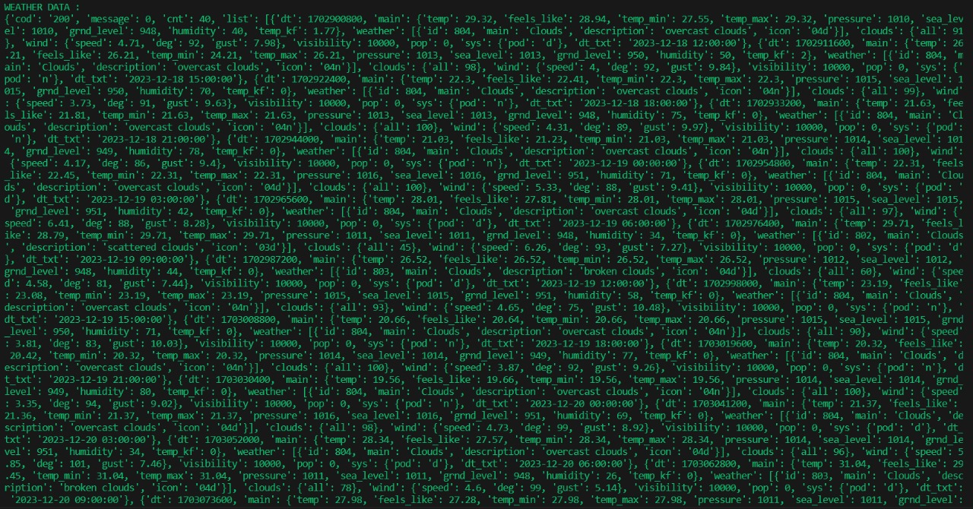
WEATHER DATA IN JSON FILE

Slide 11
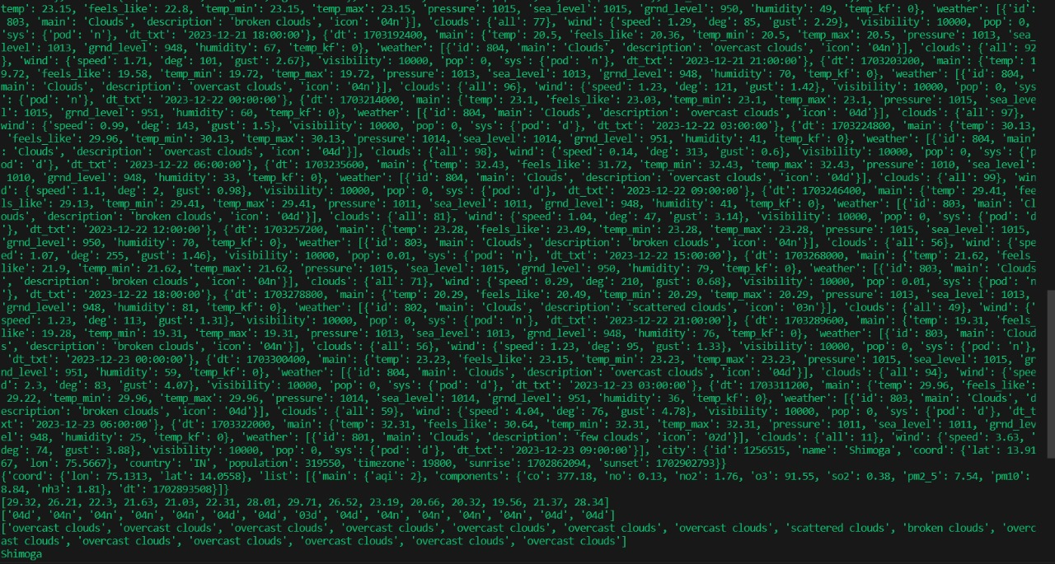
WEATHER DATA IN JSON FILE

Slide 12
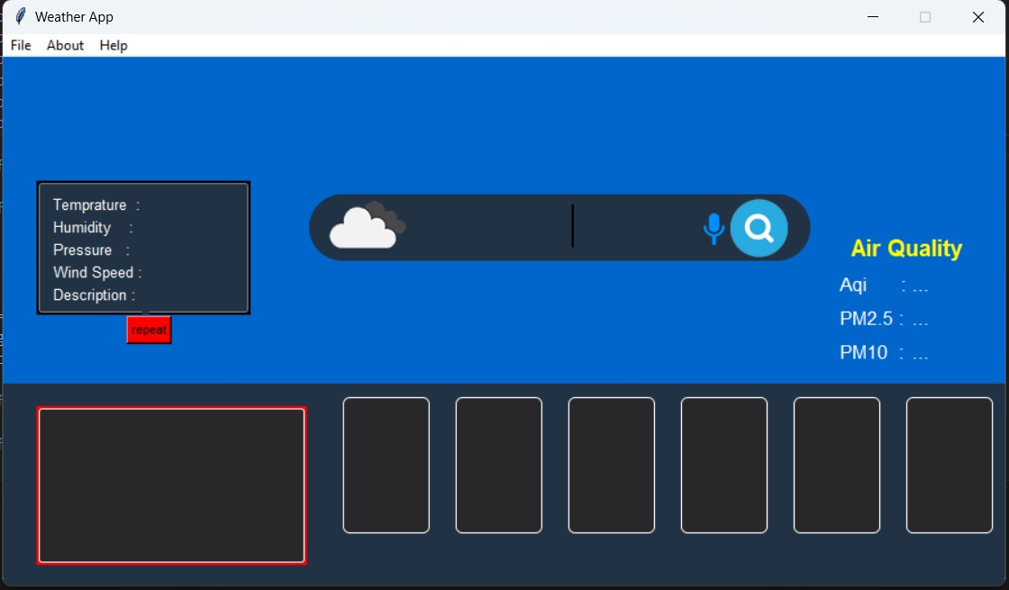

Slide 13
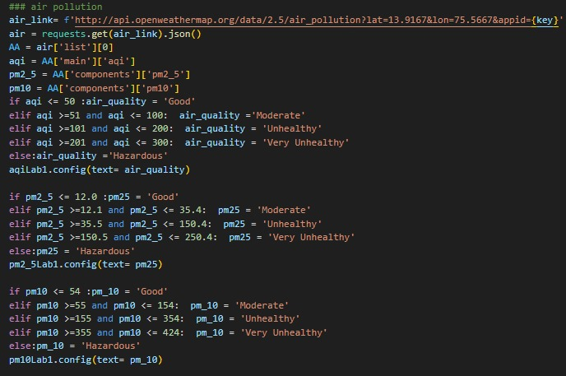
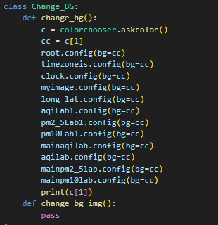
AIR QUALITY CHECKER
BACKGROUND COLOUR CHANGER

Slide 14
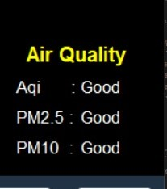
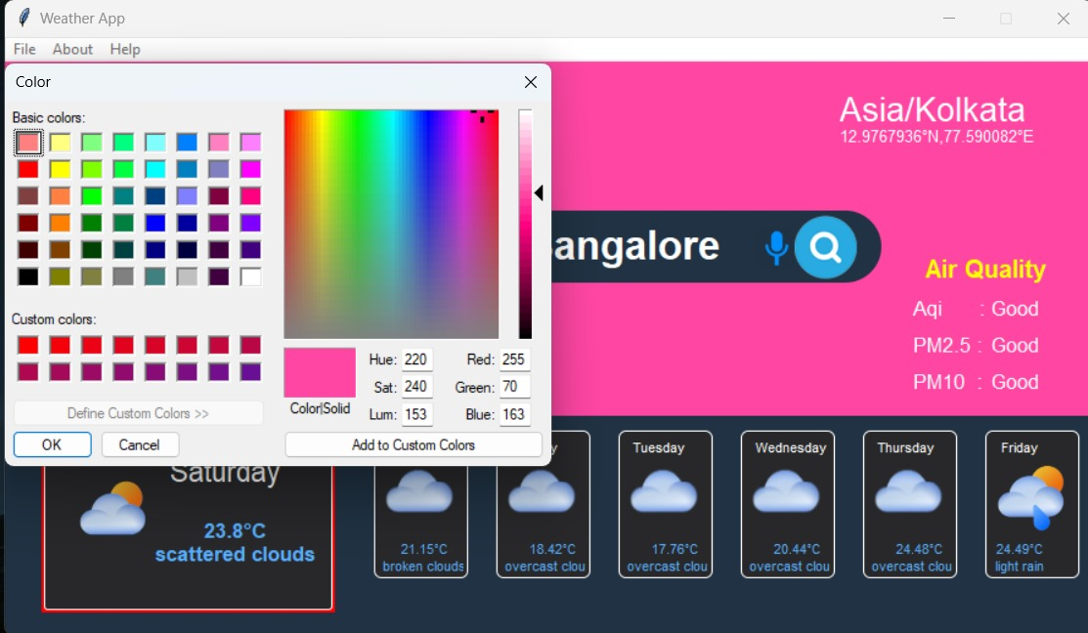

Slide 15
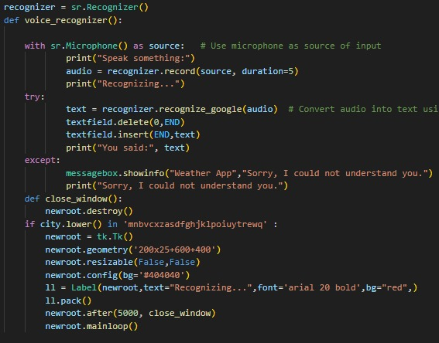
VOICE TO TEXT CONVERTER

Slide 16
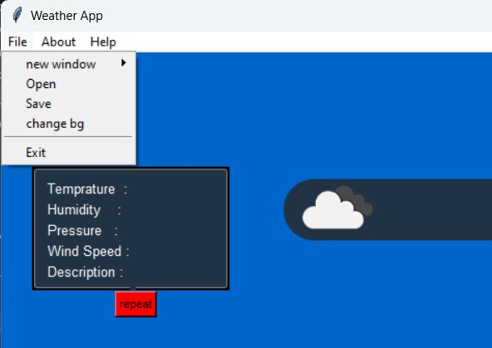
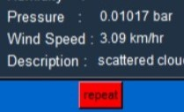

Slide 17
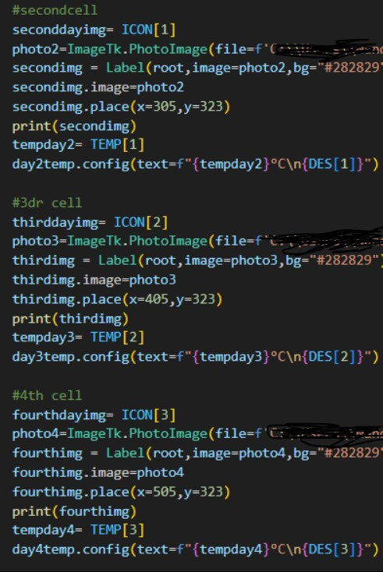
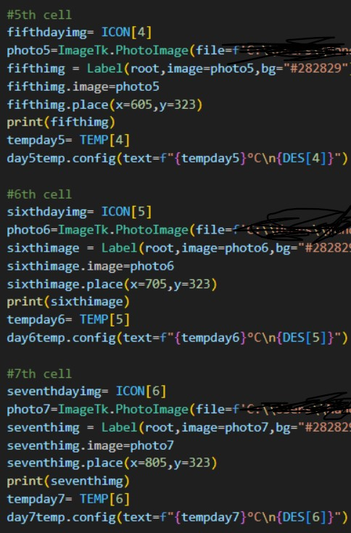
SIX BOXES WEATHER DISPLAYER

Slide 18
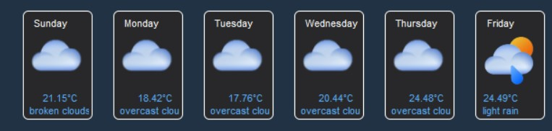
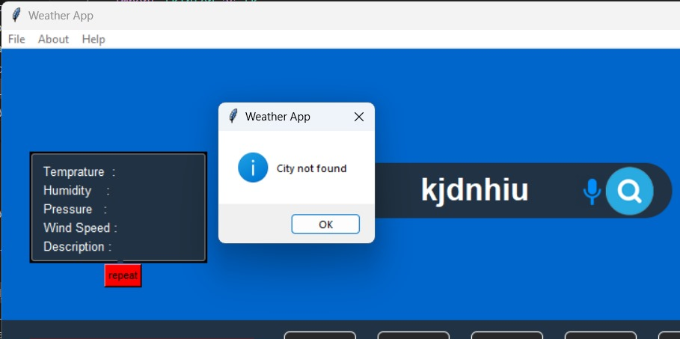

Slide 19
END USER
People traveling on a daily basis intra city get hourly updates about weather.
People planning to go on a vacation to other cities can get to know about the weather in that place for the next five days and can help them to plan accordingly.

Slide 20
LEARNING,CONCLUSION & FUTURE WORK
We got lot of experience and exposure to python language and
how much features are in python , Especially there are lot of libraries
In python.
This project was concentrated more to GUI and modules and to understand the mechanism of Application Programming Interface (API).
API is a intermediary software that allows application to communicate with each other.
This project also helped us in learning about speech to text and text to speech small application which we made.

Slide 21
REFERENCES
https://www.youtube.com/
https://www.geeksforgeeks.org/python-programming-language/
https://pypi.org/

Slide 22
THANK YOU

